Slide 1
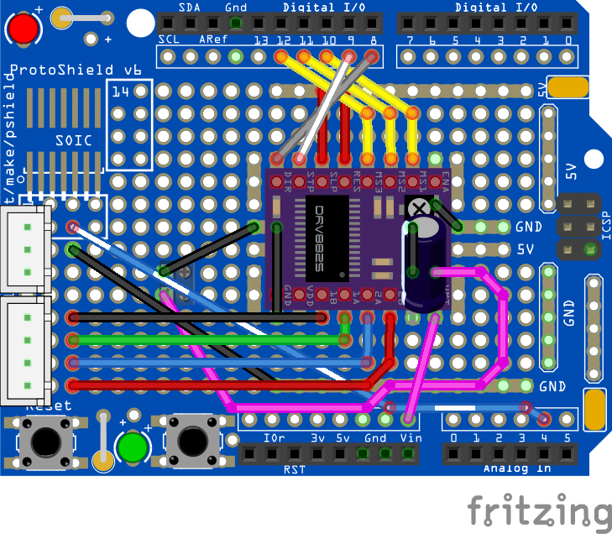
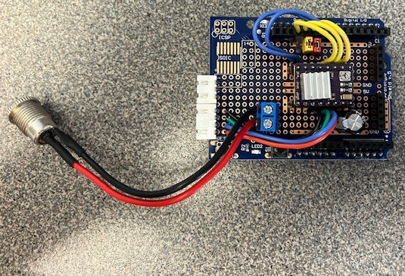
Arduino “BLI” DRV8825 biopolar stepper motor driver shield
Uses Arduino Protoshield (v6 shown in Fritzing drawing)
Tested with a NEMA 17 bipolar stepper motor (1.5A max current) and 8:1 microstepping. Board should support up to 2A with adequate cooling.
NO
GND
NC
1B
1A
2A
2B
Control signals:
DIR: Arduino pin 8
STP (step): Arduino pin 9
MS1: Arduino pin 10 (microstepping bits)
MS2: Arduino pin 11
MS3: Arduino pin 12
SLP (sleep) and RES (reset) are pulled high with jumpers in this prototype but can be soldered to 5V as indicated in the drawing.
Copyright 2026 Andrew B. Greytak, University of South Carolina – Documentation shared via CC-BY-SA-4.0
https://github.com/Greytak-Chemistry-Lab/arduino-bli-mono-controller/LICENSE

Slide 2
Parts list
Part | Part Number / Supplier | Note
DRV8825 stepper motor breakout | Stepper Motor Driver Module for 3D Printer Stepper Driver 4-Layer PCB Board (Amazon/”EC Buying”, purchased as 5 pack w/ heatsinks
Limit switch (3-pin end stop switch) | WELWIK (Amazon)
Limit switch cable (1M XH2.54 3PIN Cable Endstop Switch Wire) | GRGRG (Amazon) | XH2.54 male/male
Stepper motor cable 4pin to 6pin, 1.5 M | TIEXYE (Amazon) (Compatible with NEMA 17 for Ender 3 printer) | XH2.54 mm 4pin male / PH 2.0 6pin male
100 microfarad electrolytic capacitor
JST XH2.5 2.54mm pitch socket plug adapter, 3 pin | From Amazon JST XH2.5 DIP header variety pack | Pin 1 on left when looking into plug. NO(A4)/GND/NC
JST XH2.5 2.54mm pitch socket plug adapter, 4 pin | From Amazon JST XH2.5 DIP header variety pack | Pin 1 on left when looking into plug. 1B/1A/2A/2B
2-pin screw terminal block for power input (tested with 12V) | Amazon | 9V min for DRV8825, 12V max for Arduino
3D designs copyright 2024 Gryphon A. Drake
Documentation Copyright 2026 Andrew B. Greytak, University of South Carolina – Documentation shared via CC-BY-SA-4.0
https://github.com/Greytak-Chemistry-Lab/arduino-bli-mono-controller/LICENSE

